Slide 2
ID Document prebuilt model

Slide 3
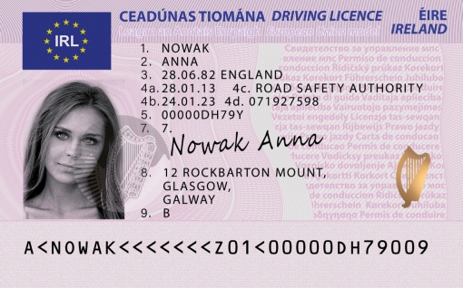
Irish Driving License
First Name: ANNA has confidence: 0.716
Last Name: NOWAK has confidence: 0.714
Document Number: 00000DH79Y has confidence: 0.858
Date of Birth: 1982-06-28 has confidence: 0.782
Date of Expiration: 2023-01-24 has confidence: 0.852
Address: AddressValue(
house_number=12,
po_box=None,
road=ROCKBARTON,
city=MOUNT, GLASGOW,
state=None,
postal_code=None,
country_region=None,
street_address=12 ROCKBARTON,
unit=None,
city_district=None,
state_district=GALWAY,
suburb=None,
house=None,
level=None) has confidence: 0.716

Slide 4
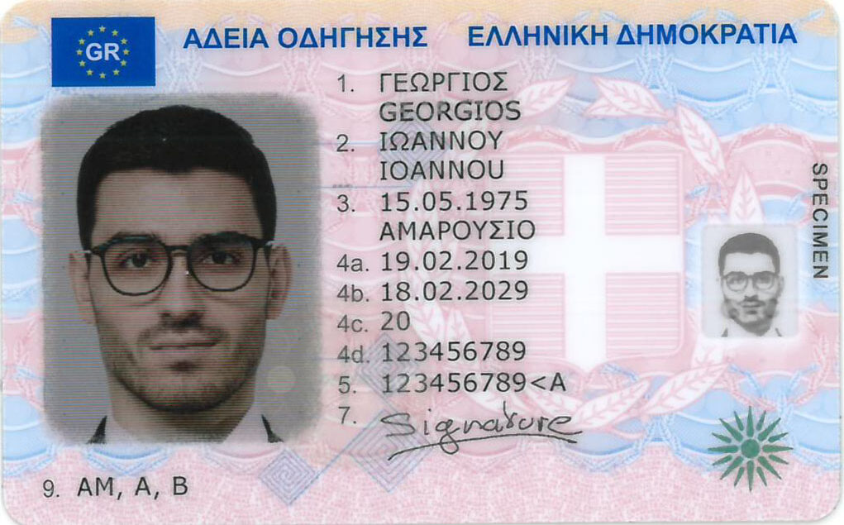
Greek Driving License
First Name: INANNOY IOANNOU confidence: 0.667
Last Name: TEQPRIOE GEORGIOS confidence: 0.639
Document Number: 123456789<A confidence: 0.86
Date of Birth: 1975-05-15 has confidence: 0.859
Date of Expiration: 2029-02-18 has confidence: 0.861

